Slide 1
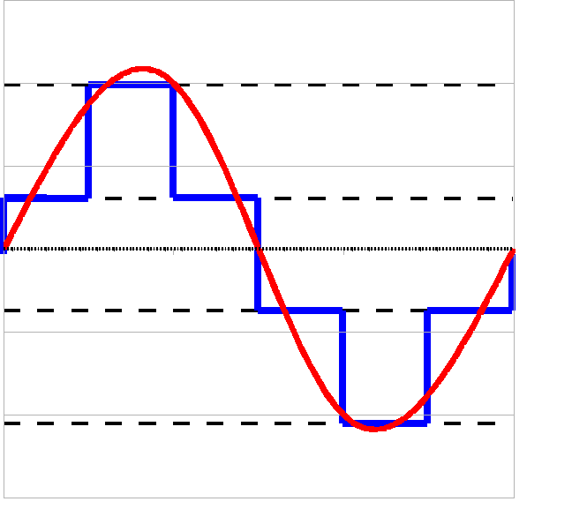

Slide 2
3 (11)_{bin}
2 (10)_{bin}
1 (01)_{bin}
0 (00)_{bin}

Slide 3
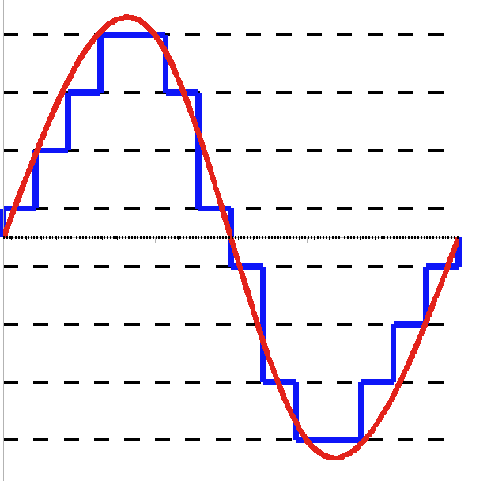
7 (111)_{bin}
6 (110)_{bin}
5 (101)_{bin}
4 (100)_{bin}
3 (011)_{bin}
2 (010)_{bin}
1 (001)_{bin}
0 (000)_{bin}

